Slide 1
Adhithyan.R
713921106001
adhithyanrajkumar7@gmail.com
Innovation In Noise Pollution Monitoring Using Iot

Slide 2
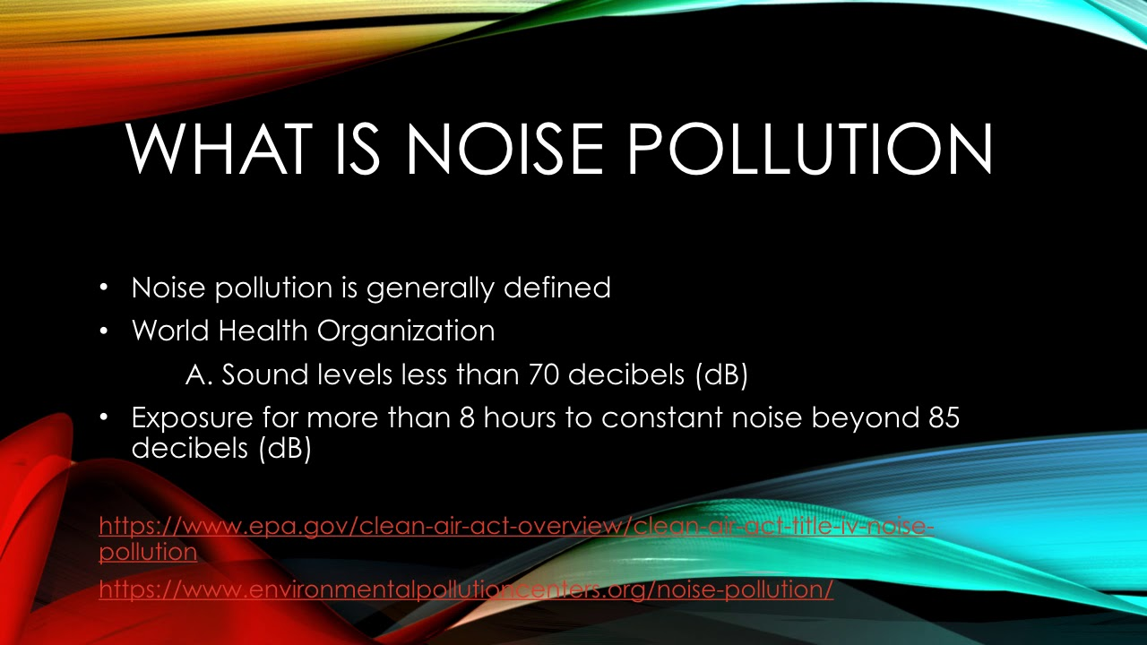
Introduction to Innovation in Noise Pollution Monitoring using IoT
Noise pollution is a growing concern in urban areas, affecting human health and well-being.
IoT (Internet of Things) technology offers a promising solution for efficient noise pollution monitoring.
This presentation explores the innovative ways IoT is being used to monitor and mitigate noise pollution.

Slide 3
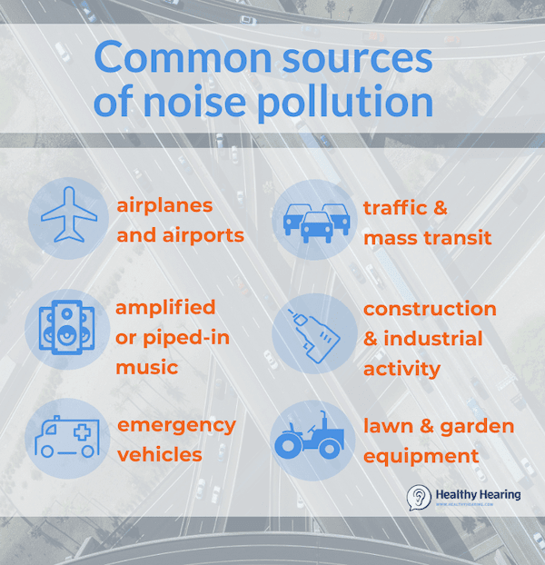
Understanding Noise Pollution
Noise pollution refers to excessive or unwanted sounds that disrupt the environment.
It can be caused by various sources such as traffic, construction, industrial activities, and even recreational events.
Noise pollution has significant negative impacts on human health, including stress, hearing loss, and sleep disturbance.

Slide 4
IoT and Noise Pollution Monitoring
IoT enables real-time monitoring and analysis of noise pollution levels using interconnected devices.
Smart sensors placed strategically in urban areas collect data on noise levels, patterns, and sources.
These sensors can be integrated with existing infrastructure or deployed as standalone devices to provide accurate measurements.

Slide 5
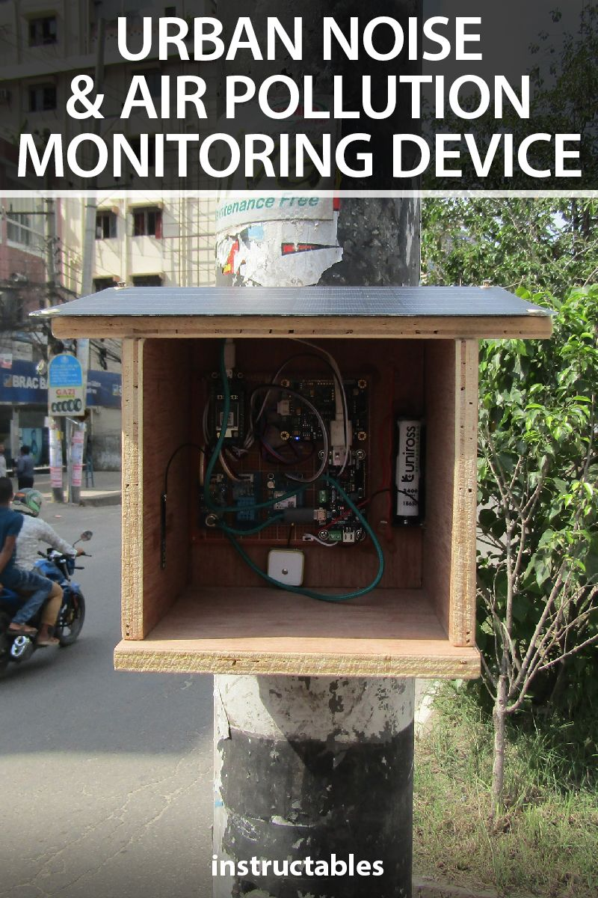
Benefits of IoT-based Noise Pollution Monitoring
Real-time monitoring allows for immediate identification of noise pollution hotspots.
Data-driven insights enable policymakers to make informed decisions for urban planning and noise regulation.
IoT-based monitoring systems can be cost-effective and scalable, covering larger areas compared to traditional methods.

Slide 6
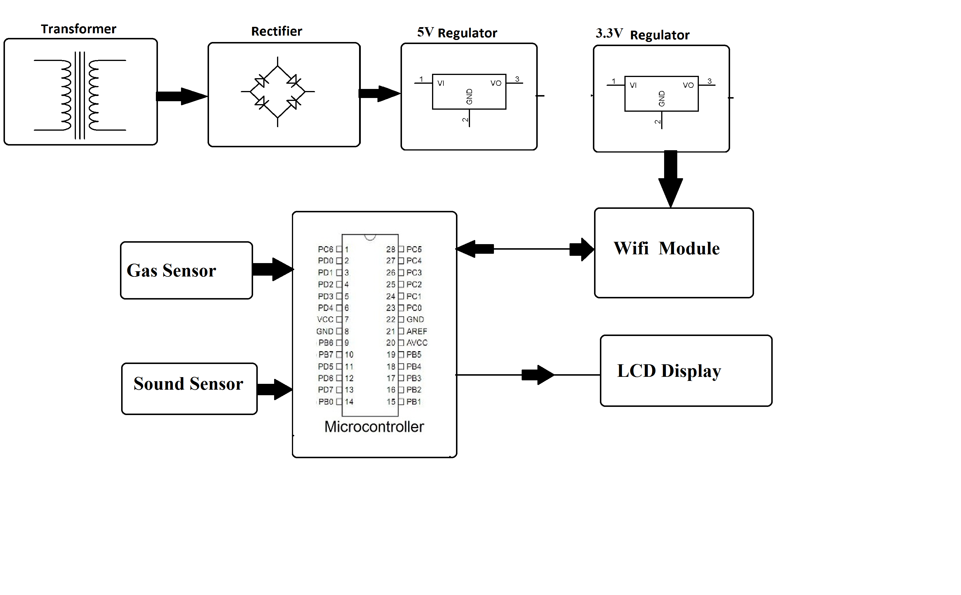
Innovative IoT Technologies for Noise Pollution Monitoring
Machine learning algorithms can be used to analyze noise data and identify specific noise sources.
IoT devices can be equipped with geolocation capabilities to provide spatial context to noise pollution data.
Integration with smart city platforms enables holistic management of noise pollution alongside other environmental factors.

Slide 7
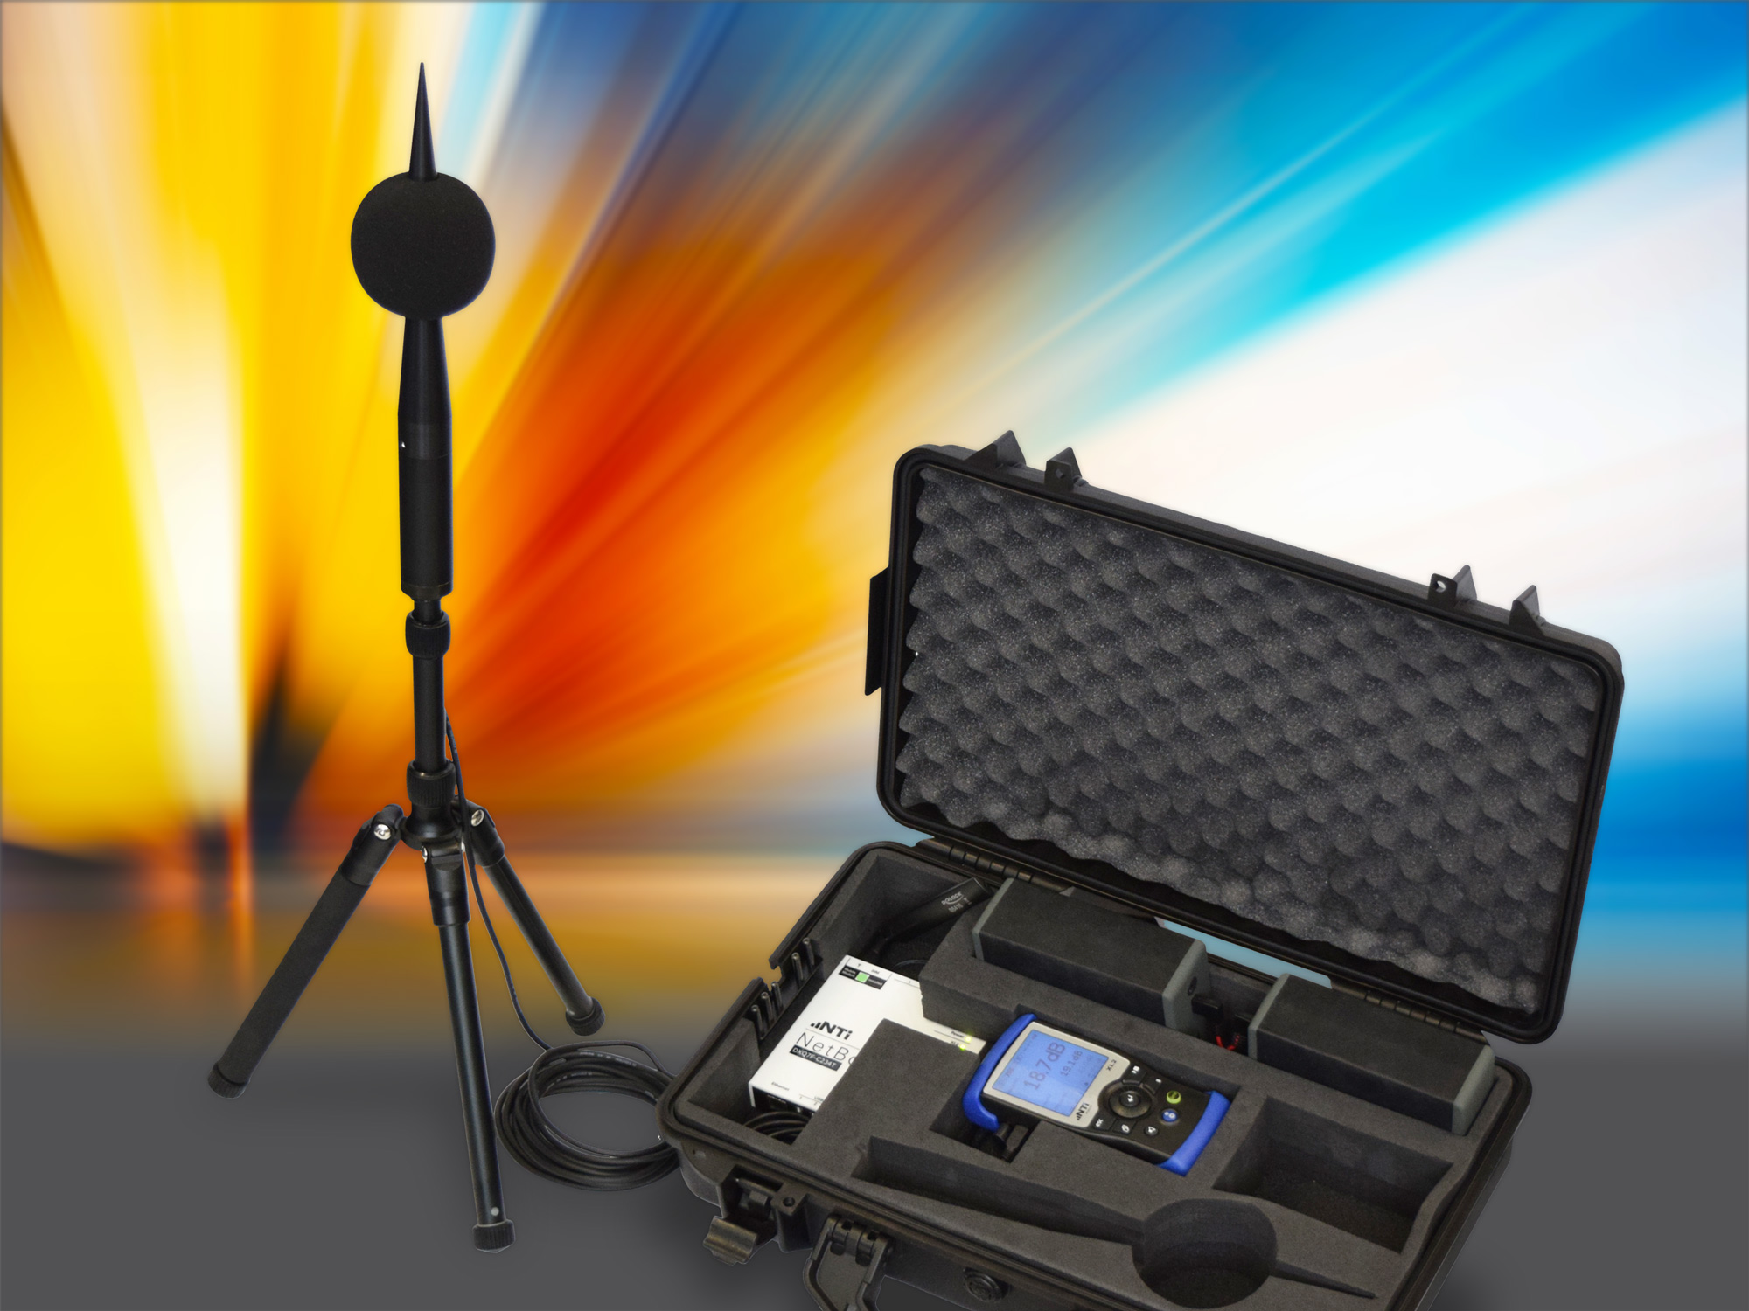
Case Studies and Success Stories
In Barcelona, IoT-based noise monitoring systems have been used to identify and mitigate noise pollution hotspots.
The city of Amsterdam implemented an innovative noise monitoring project using IoT sensors to improve the quality of life for residents.
Singapore's National Environmental Agency utilizes IoT technology to monitor noise levels at construction sites and enforce noise regulations.

